Slide 1
Introduction
The outputs of the digital circuits are dependent entirely on their inputs.
However, there are requirements for a digital device or circuit whose output will remain unchanged, once set, even if there is a change in input level(s). Such a device could be used to store a binary number called Flip-Flop.
Flip-flops are used in the construction of registers and counters, and in numerous other applications.
In a sequential logic circuit flip-flops serve as key memory elements.
Analysis of such circuits are done through truth tables or characteristic equations of flip-flops. The analysis result is normally presented through state table or state transition diagram and also through timing diagram.

Slide 2
Introduction
There are two types of sequential circuits:
synchronous: outputs change only at specific time
asynchronous: outputs change at any time
Multivibrator: a class of sequential circuits. They can be:
bistable (2 stable states)
monostable or one-shot (1 stable state)
astable (no stable state)
Bistable logic devices: latches and flip-flops.
Latches and flip-flops differ in the method used for changing their state.

Slide 3
Memory Elements
Memory element: a device which can remember value indefinitely, or change value on command from its inputs.
Characteristic table:
Memory element
Q
command
stored value
Q(t): current state
Q(t+1) or Q⁺: next state

Slide 4
Memory Elements
Memory element with clock. Flip-flops are memory elements that change state on clock signals.
Clock is usually a square wave.
Memory element
Q
command
stored value
clock
Positive pulses
Positive edges
Negative edges

Slide 5
Memory Elements
Two types of triggering/activation:
pulse-triggered
edge-triggered
Pulse-triggered
latches
ON = 1, OFF = 0
Edge-triggered
flip-flops
positive edge-triggered (ON = from 0 to 1; OFF = other time)
negative edge-triggered (ON = from 1 to 0; OFF = other time)

Slide 6
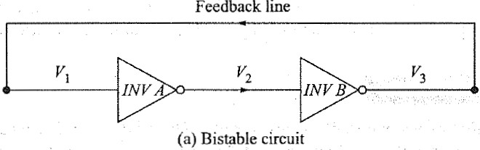
RS FLIP-FLOPS-3
Basic Idea
One of the easiest ways to construct a flip-flop is to connect two inverters in series as shown in Figure. The line connecting the output of inverter B (INV B) back to the input of inverter A (INV A) is referred to as the feedback line.

Slide 7
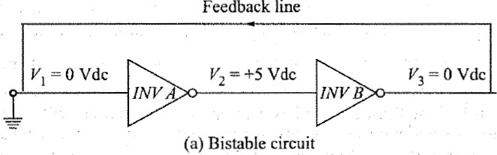
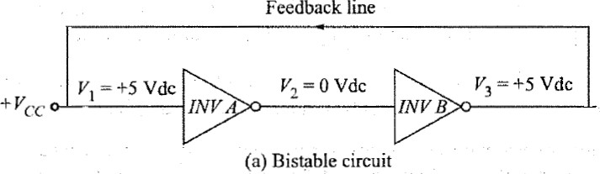
RS FLIP-FLOPS-3

Slide 8
RS FLIP-FLOPS-4
NOR-Gate latch
The basic flip-flop can be improved by replacing the inverters with either NAND or NOR gates.
The additional inputs on these gates provide a convenient means for application of input signals to switch the flip-flop from one stable state to the other.

Slide 9
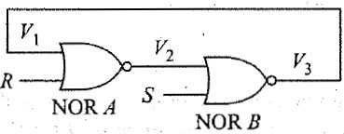
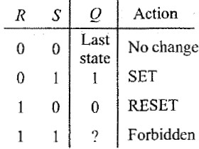
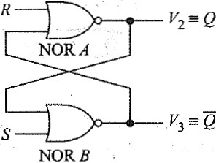
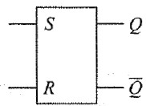
RS FLIP-FLOPS-5
Two inputs labeled R and S.
Two outputs, defined in more general terms as Q and Q’.

Slide 10
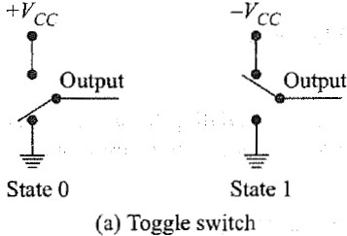
RS FLIP-FLOPS-1
•
Any device or circuit that has two stable states is said to be bistable.
For instance, a toggle switch has two stable states.
•
•
It is either up or down, depending on the position of the switch.
The switch is also said to have memory since it will remain as set until someone changes its position.
•

Slide 11
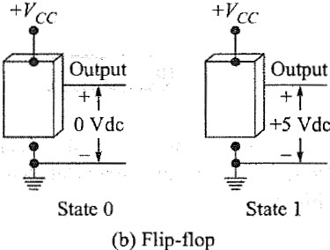
RS FLIP-FLOPS-2
•
A flip-flop is a bistable electronic circuit that has two stable states-that is, its output is either 0 or +5V.
The flip-flop also has memory since its output will remain as set until something is done to change it.
In fact, any bistable device can be used to store one binary digit (bit).
For instance, when the flip-flop has its output set at 0V dc, it storing a logic 0 and when its output is set at + 5 V dc, as storing a logic 1.
The flip-flop is often called a latch, since it will hold, or latch, in either stable state.
•
•
•

Slide 12
RS FLIP-FLOPS-6
•
To aid in understanding the operation of this circuit, recall that an H = 1 at any input of a NOR gate forces its output to an L = 0.
The first input condition in the truth table is R = 0 and S
= 0. Since a 0 at the input of a NOR gate has no effect on its
•
output, the flip-flop simply remains in its present state; that is, Q remains unchanged.

Slide 13
RS FLIP-FLOPS-7
•
The second input condition R = 0 and S = 1 forces the output of NOR gate B low.
Both inputs to NOR gate A are now low, and the NOR- gate output must be high.
Thus a 1 at the S input is
•
•
said to SET the flip-flop, and it switches to the stable state where Q = 1.

Slide 14
RS FLIP-FLOPS-8
•
The third input condition is R
= 1 and S = 0. This condition
forces the output of NOR gate A low, and since both inputs to NOR gate B are
now low, the output must be high.
Thus a 1 at the R input is said to RESET the flip-flop and it switches to the stable state where Q = 0 (or Q’ = 1).
•

Slide 15
RS FLIP-FLOPS-9
•
The last input condition in the table, R = 1 and S = 1, is
forbidden, as it forces the outputs of both NOR gates to the low state.
In other words, both Q = 0 and
Q’ = 0 at the same time.
•
•
This violates
the flip-flop
basic that the
definition requires
of a
Q to be
complement of Q’, and so it is generally agreed never to impose this input condition.

Slide 16
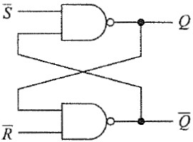
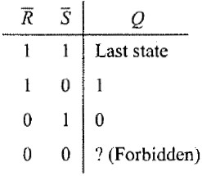
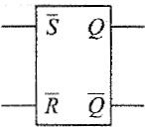
RS FLIP-FLOPS-10
•
•
•
NAND-Gate latch
Also called as flip-flop.
Alow on any input to a NAND gate will force its output high.
Thus a low on the S input will set the latch (Q = 1 and Q’ = 0).
A low on the R input will reset it (Q
= 0).
If both R and S are high, the flip-flop will remain in its previous state.
•
•
•
•
R and S low simultaneously is forbidden since this forces both Q and Q’ high.

Slide 17
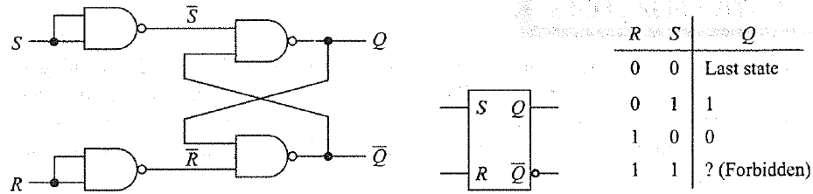
RS FLIP-FLOPS-11
Show how to convert the flip-flop.
By placing an inverter at each input
flip-flop into an RS
flip-flop,
the 2 inputs are now R and S, and the resulting circuit behaves exactly as the RS flip-flop.

Slide 18
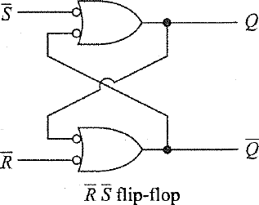
RS FLIP-FLOPS-12
Bubbled OR-gate equivalent to flip-flop

Slide 19
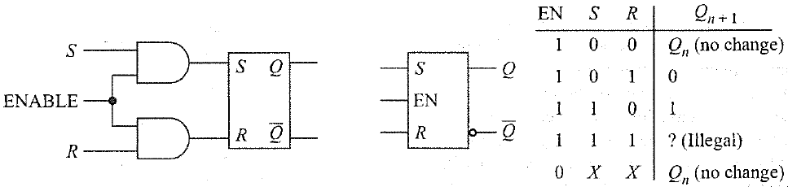
GATED FLIP-FLOPS-1
Clocked RS Flip-Flops
The addition of two AND gates at the R and S inputs as shown in figure will result in a flip-flop that can be enabled or disabled.
When the ENABLE input is low, the AND gate outputs must both be low and changes in neither R or S will have any effect on the flip-flop output Q. The latch is said to be disabled.
Strobe or clock the flip-flop in order to store information (set it or reset it) at any time, and then hold the stored information for any desired period of time. This flip-flop is called a gated or clocked RS flip-flop.
The time before the ENABLE goes low Q_{n} and the time just after ENABLE goes low Q_{n+ 1}.

Slide 20
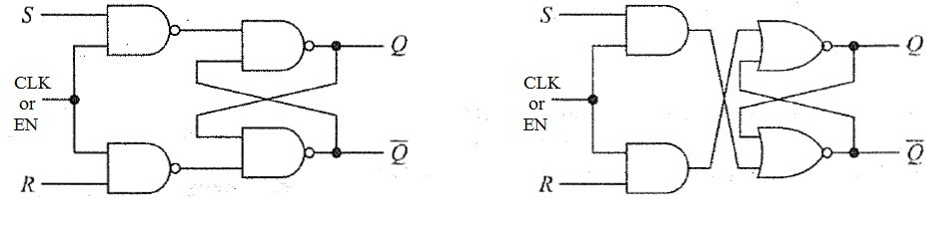
GATED FLIP-FLOPS-2
Two different realizations for a clocked RS
flip-flop

Slide 21
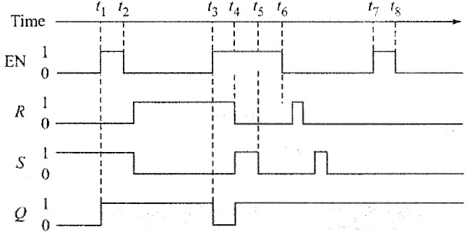
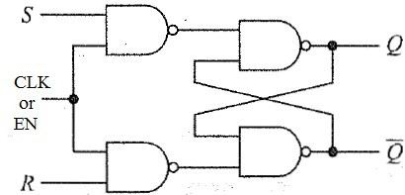
GATED FLIP-FLOPS-3
Below figure shows the input waveforms R, S, and EN applied to a clocked RS flip- flop. Explain the output waveform Q.

Slide 22
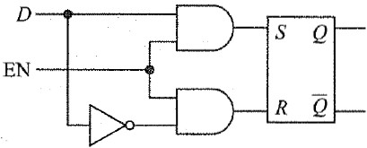
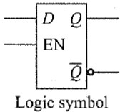
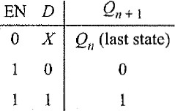
GATED FLIP-FLOPS-4
•
•
Clocked D Flip-Flops
A D (Data) flip-flop having one input.
This flip-flop is disabled when EN is low, but is transparent when EN is high.
D flip-flop in which Q can follow the value of D while EN is high.
•
•
•
In other words, if the data bit changes while EN is high, the last value of D before EN return low is the value of D that is stored.
This kind of D flip-flop is often called a D latch.
•

Slide 25
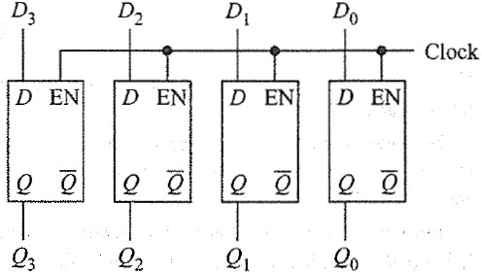
GATED FLIP-FLOPS-5
The idea of data storage in D Flip-Flop
Four D latches are driven by the same clock signal.
When the clock goes high, input data is loaded into the flip-flops and appears at the output.
Then when the clock goes low, the output retains the data.

Slide 26

EDGE-TRIGGERED RS FLIP-FLOPS -1
If any of these flip-flops are used in a synchronous system, care must be taken to ensure that all flip-flop inputs change state in synchronism with the clock.
One way of resolving the problem for gated flip-flops is to allow changes in R, S, and D input levels only when EN is low or require fixed levels at R, S, and D any time EN is high.
Nearly all of the circuits in a digital system ( computer) change states in
Synchronism with the system clock.
A change of state will either occur as the clock transitions from low to high or as it transitions from high to low.
The low-to-high transition is frequently called the positive transition (PT), as shown in Figure. The PT is given emphasis by drawing a small arrow on the rising edge of the clock waveform.
A circuit that changes state at this time is said to be positive-edge-triggered. The high-to-low transition is called the negative transition (NI), as shown in Figure.

Slide 27
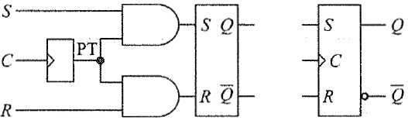
EDGE-TRIGGERED RS FLIP-FLOPS -2
Positive-Edge-Triggered RS Flip-flops
The small triangle inside the symbol (dynamic input indicator) indicates that Q can change state only with PTs of the clock (C).
Each PT of the clock produces a very narrow PT that is applied to the AND gates.
The AND gates are active only while the PT is high (perhaps 25 ns), and thus Q can change state only during this short time period. In this manner Q changes state in synchronism with the PTs of the clock.

Slide 28
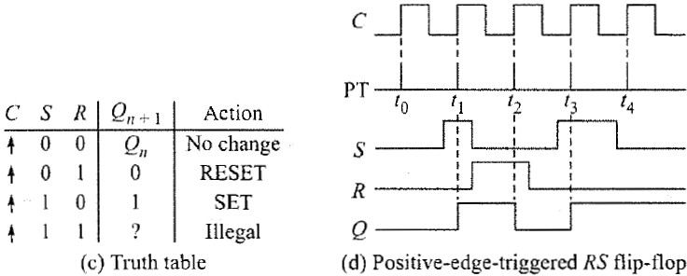
EDGE-TRIGGERED RS FLIP-FLOPS -3
Truth Table and Timing Diagram

Slide 29
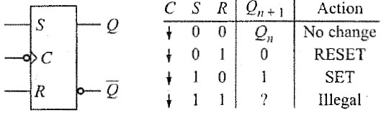
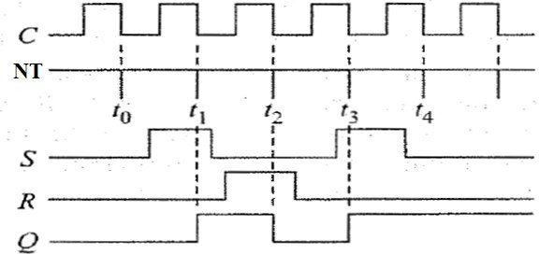
EDGE-TRIGGERED RS FLIP-FLOPS -4
Negative-Edge-Triggered RS Flip-Flops
The small bubble on the clock input ( C) means active-low.

Slide 30
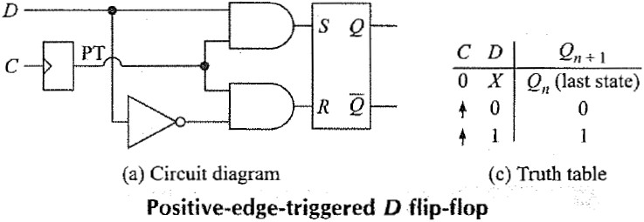
EDGE-TRIGGERED D FLIP-FLOPS -1
When the clock is low, D is a don't care and Q
is latched in its last state.
On the leading edge of the clock (PT), designated by the up arrow, the data bit is loaded into the flip-flop and Q takes on the value of D.

Slide 31
EDGE-TRIGGERED D FLIP-FLOPS -2
To get some computers started, an operator has to push a RESET button. This sends a CLEAR or PRESET signal to all flip-flops. Also, it's necessary in some digital systems to preset (synonymous with set) certain flip-flops.

Slide 32
J K FLIP FLOP
J-Jack K- Kilby (Jack Kilby inventor of Integrated Circuits in 1958 and the Hand-held Calculator in 1966)
Setting R = S = 1 with an edge-triggered RS flip- flop forces both Q and to the same logic level. This is an illegal condition, and it is not possible to predict the final state of Q.
The JK flip-flop accounts for this illegal input, and is therefore a more versatile circuit.
Flip-flops can be used to build counters³.⁰

Slide 33
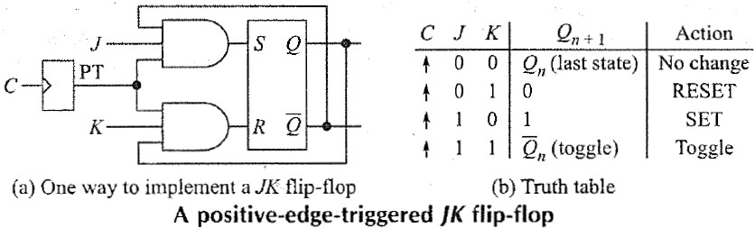
JK FLIP-FLOPS -2
Positive-Edge-Triggered J K Flip-Flops
The basic circuit is identical to the previous positive-edge- triggered RS flip-flop, with two important additions:
The Q output is connected back to the input of the lower AND gate.
The output is connected back to the input of the upper AND gate.
This cross-coupling from outputs to inputs changes the RS flip- flop into a JK flip-flop. The previous S input is now labelled J, and the previous R input is labelled K.

Slide 35
JK FLIP-FLOPS
How it works:
When J and K are both low, both AND gates are disabled. Therefore, clock pulses have no effect.
This first possibility is the initial entry in the truth table. As shown, when J and K are both 0s, Q retains its last value.

Slide 36
EDGE-TRIGGERED JK FLIP-FLOPS -4
When J is low and K is high, the upper gate is disabled, so there's no way to set the flip-flop. The only possibility is reset.
When Q is high, the lower gate passes a RESET pulse as soon as the next positive clock edge arrives. This forces Q to become low (the second entry in the truth table). Therefore, J = 0 and K = 1 means that the next PT of the clock resets the flip-flop (unless Q is already reset).

Slide 37
EDGE-TRIGGERED JK FLIP-FLOPS -5
When J is high and K is low, the lower gate is disabled, so it's impossible to reset the flip- flop.
When Qis low, is high; therefore, the upper gate passes a SET pulse on the next positive clock edge. This drives Q into the high state (the third entry in the truth table).
As, J = 1 and K = 0 means that the next PT of the clock sets the flip-flop (unless Q is already
high).
34

Slide 38
EDGE-TRIGGERED JK FLIP-FLOPS -6
When J and K are both high, it's possible to set or reset the flip-flop.
If Q is high, the lower gate passes a RESET pulse on the next PT. On the other hand, when Q is low, the upper gate passes a SET pulse on the next PT.
Either way, Q changes to the complement of the last state (see the truth table).
Therefore, J = 1 and K = 1 mean the flip-flop will toggle (switch to the opposite state) on the next positive clock edge.

Slide 40
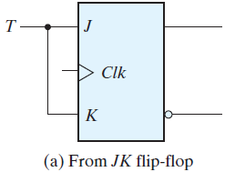
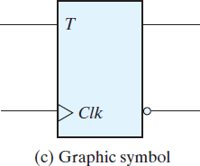
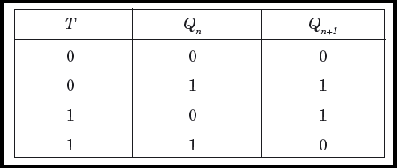
EDGE-TRIGGERED JK FLIP-FLOPS -8
Toggle flip-flop, popularly known as T flip-flop has following input- output relation.
When input T = 0, the output Q does not change its state. For T = 1, the output Q toggles its value.
For JK flip-flop input J = K = 0, the output Qn+ 1 = Qn i.e. output does not change its state.
For J = K = 1, the output Qn+1 = Qn’ i.e. output toggles.
Thus, if we tie J and K inputs of JK flip-flop together and make a common input T = J = K, the resulting circuit will behave as T flip- flop.

Slide 41
FLIP-FLOP TIMING-1
Diodes and transistors cannot switch states immediately.
It always takes a small amount of time to turn a diode on or off. A transistor takes time for to switch from saturation to cut-off, and vice versa.
For bipolar diodes and transistors, the switching time is in the nanosecond region.
Switching time is the main cause of propagation delay (tp). This represents the amount of time it takes for the output of a gate or flip-flop to change states after the input changes.
For instance, if an edge-triggered D flip-flop lists tp= 10 ns, it takes about 10 ns for Q to change states after D has been sampled by the clock edge.
This propagation delay time has been used to construct the "pulse-forming circuit" used with edge-triggered flip-flops.
When flip-flops are used to construct counters, the propagation delay is often small enough to be ignored.

Slide 42
FLIP-FLOP TIMING-2
The D input makes it necessary for data bit D to be at the input before the clock edge arrives.
The setup time (t_{setup}) is the minimum amount of time that the data bit must be present before the clock edge hits.
E.g. a D flip-flop has a setup time of 15 ns, the data bit to be stored must be at the D input at least 15 ns before the clock edge arrives; otherwise, the not guarantee correct sampling and storing.
Data bit D has to be held long enough for the internal transistors to switch states. Only after the transition is assured can allow data bit D to change.
Hold time (t_{hold}) is the minimum amount of time that data bit D must be present after the PT of the clock.
E.g., if t_{setup} = 15 ns and t_{hold} = 5 ns, the data bit has to be at the D input at least 15 ns before the clock edge arrives and held at least 5 ns after the clock PT.

Slide 43
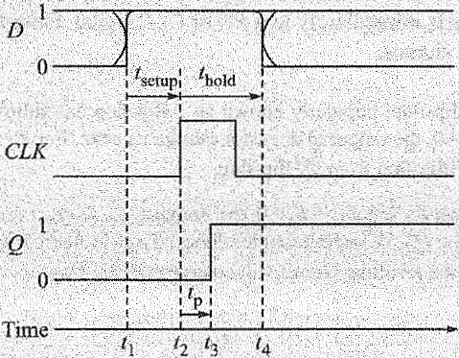
FLIP-FLOP TIMING-3
•
Typical waveforms for setting a 1 in a positive-edge-triggered flip-flop.
Prior to t1, the data can be a 1 or a 0, or can be changing.
From time t1 to t2, the data line D must be held steady. This is the setup time tsetup.
Data is shifted into the flip-flop at time t2
but does not appear at Q until time t3.
The time from t2 to t3 is the propagation time tp.
In order to guarantee proper operation, the data line must be held steady from time t2 until t4; this is the hold time t_{hold}.
After t4, D is free to change state.
•
•
•
•
•

Slide 45
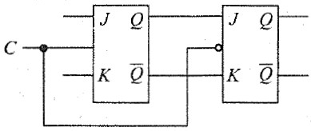
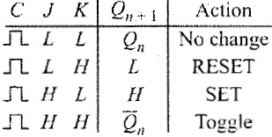
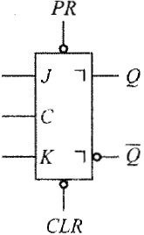
JK MASTER-SLAVE FLIP-FLOPS-1
•
To begin with, the master is
positive-level-triggered and the slave is negative-level-triggered.
Therefore, the master responds to its J and K inputs before the slave.
If J = 1 and K = 0, the master sets on the positive clock transition. The high Q output of the master drives the J input of the slave, so on the negative clock transition,
•
•
the slave sets, copying the action of the master.

Slide 46
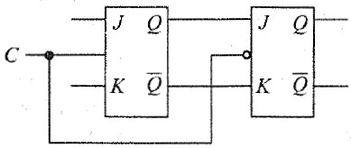
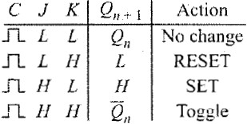
JK MASTER-SLAVE FLIP-FLOPS-2
•
If J = 0 and K = 1, the master resets on the PT of the clock. The high output of the master goes to the K input of the slave.
Therefore, the NT of the clock forces the slave to reset.
Again, the slave has copied the master.
•
•

Slide 47
JK MASTER-SLAVE FLIP-FLOPS-3
•
If the master's J and K inputs are both high, it toggles on the PT of
the clock and the slave then
toggles on the clock NT. Regardless of what the master
does, therefore, the slave copies it: if the master sets, the slave sets; if the master resets, the slave resets.
•
•
If J = K = 0, the flip-flop is disabled and Q remains unchanged.

Slide 48
JK MASTER-SLAVE FLIP-FLOPS-4
The truth table reveals this action by means of the pulse symbol
.
Second, the symbol appearing next to the Q and the Q’ outputs is the IEEE designation for a postponed output.
In this case, it means Q does not change state until the clock makes an NT.
In other words, the contents of the master are shifting into the slave on the clock NT, and at this time Q changes state.
To summarize: The master is set according to J and K while the clock is high; the contents of the master are then shifted into the slave (Q changes state) when the clock goes low.
This flip-flop might be referred to as pulse-triggered, to distinguish it from the edge-triggered flip-flops.

Slide 49

JK MASTER-SLAVE FLIP-FLOPS-5
•
The JK master-slave flip-flop J and K inputs tied to + Vcc and a series of pulses (actually a square wave) are applied to its C input.
•
Since J=K=l, the flip-flop simply toggles each time the clock goes low.
The waveform at Q has a period twice that of the C waveform.
In other words, the frequency of Q is only one-half that of C.
This circuit acts as a frequency divider - the output frequency is equal to the input frequency divided by 2.
•
•
•

Slide 50
JK MASTER-SLAVE FLIP-FLOPS-5
Lab Experiment:
Realize a J-K Master-Slave Flip-Flop using NAND gates and verify its truth table.
J
Q
Q
CLK
Q
K
Input
Output ^{Q}n+1
J
K
0 | 0 | Q_{n}
0 | 1 | 0
1 | 0 | 1
1 | 1

Slide 51
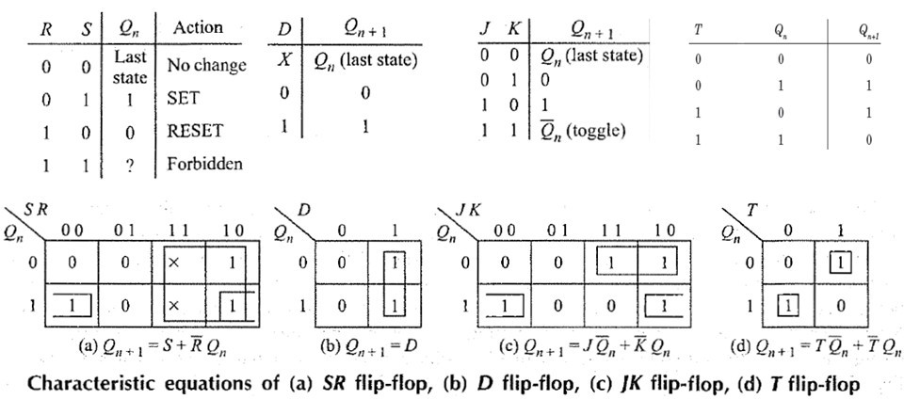
VARIOUS REPRESENTATIONS OF FLIP-FlOPS-1
Characteristic Equations of Flip-flops
The characteristic equations of flip-flops are useful in analyzing circuits made of them. Here, next output Qn+1 is expressed as a function of present output Qn and input to flip-flops.

Slide 52
VARIOUS REPRESENTATIONS OF FLIP-FlOPS-2
Flip-Flops as (FSM) Finite State Machine :
In a sequential logic circuit the value of all the memory elements at a given time define the state of that circuit at that time.
Finite State Machine (FSM) concept offers a better alternative to truth table in understanding progress of sequential logic with time. For a complex circuit a truth table is difficult to read as its size becomes too large.
In FSM, functional behavior of the circuit is explained using finite number of states.

Slide 53
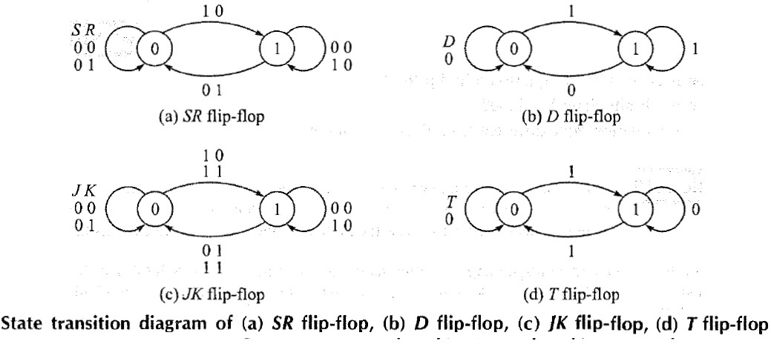
VARIOUS REPRESENTATIONS OF FLIP-FlOPS-3
All the flip-flops are represented as finite state machine through their state transition diagrams.

Slide 54
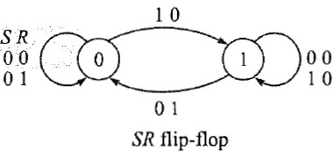
VARIOUS REPRESENTATIONS OF FLIP-FlOPS-4
•
SR flip-flop is developed from its truth table or characteristic equation. Each flip-flop can be at either of 0 or 1 state defined by its stored value at any given time. Application of input may change the stored value, i.e.
state of the flip-flop. This is shown by directional arrow and the corresponding
input is written alongside.
If SR flip-flop stores 0, then for SR = 00 or 01I the stored value does not change.
For SR= l0, flip-flop output changes to 1. Note that, SR= 11 is not allowed in SR flip- flop.
When SR flip-flop stores 1, application of SR= 00 or 10 does not change its value and only when SR= 01, output changes to 0.
10
•
SR 00
01
•
•
00
10
0
1
01

Slide 55
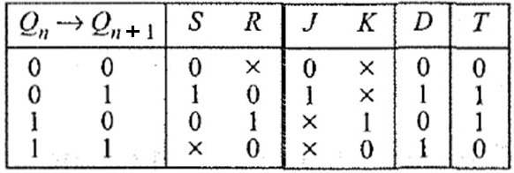
VARIOUS REPRESENTATIONS OF FLIP-FlOPS-5
Flip-Flop Excitation Table:
Excitation table of a flip-flop is looking at its truth table in a reverse way.
Here, flip-flop input is presented as a dependent function of transition Qn→Qn+ 1 and comes later in the table.
This is derived from flip-flop truth table or characteristic equation and directly from its state transition diagram.

Slide 56
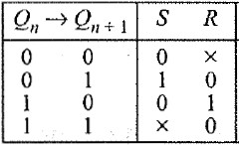
VARIOUS REPRESENTATIONS OF FLIP-FlOPS-6
•
•
Excitation table for SR Flip-Flop One can see if present state is 0
application of SR = 0x does not alter its value where 'x' denotes don't care condition in R input.
State 0 to 1 transition occurs when SR = 10 is present at the input side
While state 1 to 0 transition occurs if SR = 01.
Present state l is maintained if
SR = 0, i.e. SR = 00 or SR = 01.
•
•
•

Slide 57
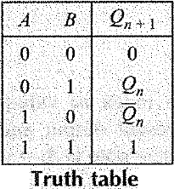
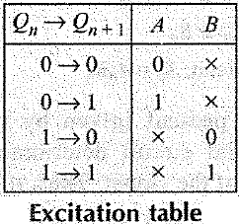
VARIOUS REPRESENTATIONS OF FLIP-FlOPS-7
•
•
Example:
A fictitious flip-flop with two inputs A and B functions like this. For AB= 00 and 11 the output becomes 0 and 1 respectively. For AB= 01, flip-flop retains previous output while output complements for AB= 10. Draw the truth table , excitation table and state transition diagrams of this flip-flop.

